Slide 1
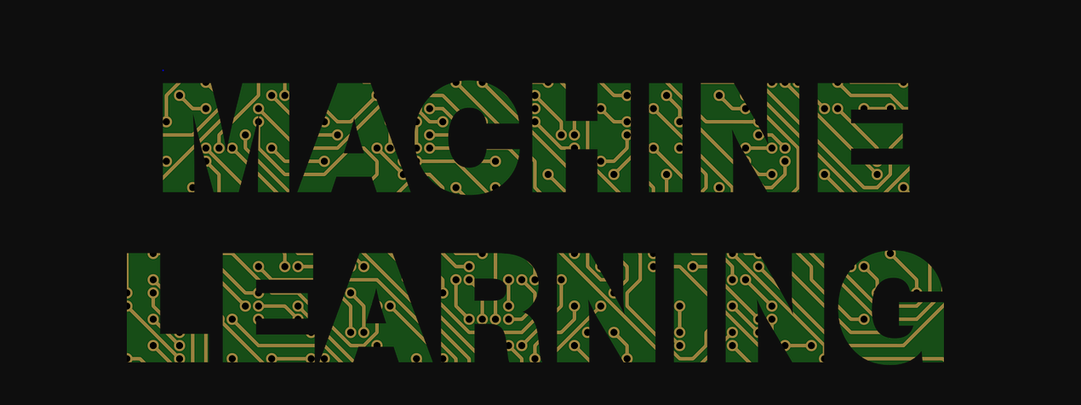
MACHINE LEARNING
MADE BY
HARSH DUBEY

Slide 2
INTODUCTION
Machine learning systems automatically learn programs from data.
This is often a very attractive alternative to manually constructing them, and in the last decade the use of machine learning has spread rapidly throughout computer science and beyond.
Machine learning is used in Web search, spam filters, recommender systems, ad placement, credit scoring, fraud detection, stock trading, drug design, and many other applications.
A recent report from the McKinsey Global Institute asserts that machine learning (a.k.a. data mining or predictive analytics) will be the driver of the next big wave of innovation.

Slide 3
MACHINE LEARNING
Herbert Alexander Simon:
“Learning is any process by which a system improve performance by experience”.
Machine learning algorithms can figure out how to perform important tasks by generalizing from examples. This is often feasible and cost-effective where manual programming is not. As more data becomes available, more ambitious problems can be tackled.

Slide 4
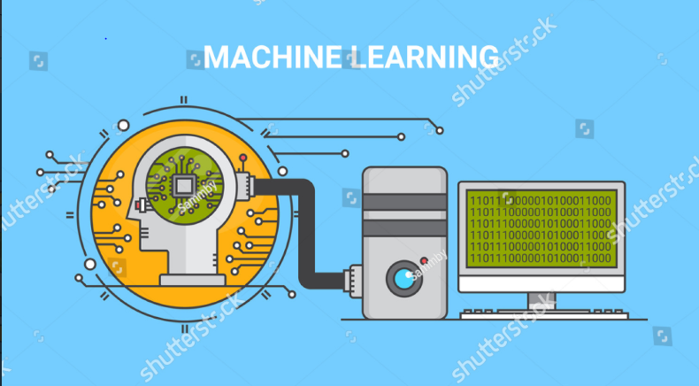

Slide 5
Why Machine Learning?
Machine learning is widely used in computer science and other fields. However, developing successful machine learning applications requires a substantial amount of “black art” that is difficult to find in textbooks.

Slide 6


Slide 7
IMPORTANCE OF MACHINE LEARNING
Learning = Representation + Evaluation + Optimization.
Suppose you have an application that you think machine learning might be good for. The first problem facing you is the bewildering variety of learning algorithms available. Which one to use? There are literally thousands available, and hundreds more are published each year. The key to not getting lost in this huge space is to realize that it consists of combinations of just three components. The components are:

Slide 8
Representation. A classifier must be represented in some formal language that the computer can handle. Conversely, choosing a representation for a learner is tantamount to choosing the set of classifiers that it can possibly learn. This set is called the hypothesis space of the learner. If a classifier is not in the hypothesis space, it cannot be learned. A related question, that I address later, is how to represent the input, in other words, what features to use.

Slide 9
Evaluation. An evaluation function (also called objective function or scoring function) is needed to distinguish good classifiers from bad ones. The evaluation function used internally by the algorithm may differ from the external one that we want the classifier to optimize, for ease of optimization and due to the issues I will discuss.

Slide 10
Optimization. Finally, we need a method to search among the classifiers in the language for the highest-scoring one. The choice of optimization technique is key to the efficiency of the learner, and also helps determine the classifier produced if the evaluation function has more than one optimum. It is common for new learners to start out using off-the-shelf optimizers, which are later replaced by custom-designed ones.
The accompanying table shows common examples of each of these three components. For example, k nearest neighbor classifies a test example by finding the k most similar training examples and predicting the majority class among them. Hyper- I plane-based methods form a linear combination of the features per class and predict the class with the highest-valued combination.

Slide 11
Representation | Evaluation | Optimization
Instances | Accuracy/Error rate | Combinatorial optimization
K-nearest neighbor | Precision and recall | Greedy search
Support vector machines | Squared error | Branch-and-bound
Hyperplanes | Likelihood | Continuous optimization
Naive Bayes | Posterior probability | Unconstrained
Logistic regression | Information gain | Gradient descent
Decision trees | K-L divergence | Conjugate gradient
Sets of rules | Cost/Utility | Quasi-Newton methods
Propositional rules | Margin | Linear programming
Logic Programs
Neural Networks
Graphical models

Slide 12
Data Alone Is Not Enough
Data alone is not enough, no matter how much of it you have. Consider learning a Boolean function of (say) 100 variables from a million examples. There are 2*100− 10*6 examples whose classes you do not know. How do you figure out what those classes are? In the absence of further information, there is just no way to do this that beats flipping a coin.
This observation was first made (in somewhat different form) by the philosopher David Hume over 200 years ago, but even today many mistakes in machine learning stem from failing to appreciate it

Slide 13
How then can we ever hope to learn anything?
Luckily, the functions we want to learn in the real world are not drawn uniformly from the set of all mathematically possible functions! In fact, very general assumptions—like smoothness, similar examples having similar classes, limited dependences, or limited complexity—are often enough to do very well, and this is a large part of why machine learning has been so successful. Like deduction, induction (what learners do) is a knowledge lever: it turns a small amount of input knowledge into a large amount of output knowledge.

Slide 14
Feature Engineering Is The Key
At the end of the day, some machine learning projects succeed and some fail. What makes the difference? Easily the most important factor is the features used. Learning is easy if you have many independent features that each correlate well with the class. On the other hand, if the class is a very complex function of the features, you may not be able to learn it.
First-timers are often surprised by how little time in a machine learning project is spent actually doing machine learning. But it makes sense if you consider how time-consuming it is to gather data, integrate it, clean it and preprocess it, and how much trial and error can go into feature design.
Learning is often the quickest part of this, but that is because we have already mastered it pretty well!

Slide 15
CONCLUSION
Like any discipline, machine learning has a lot of “folk wisdom” that can be difficult to come by, but is crucial for success. This article summarized some of the most salient items. Of course, it is only a complement to the more conventional study of machine learning.

Slide 16
Thank You

